Slide 1
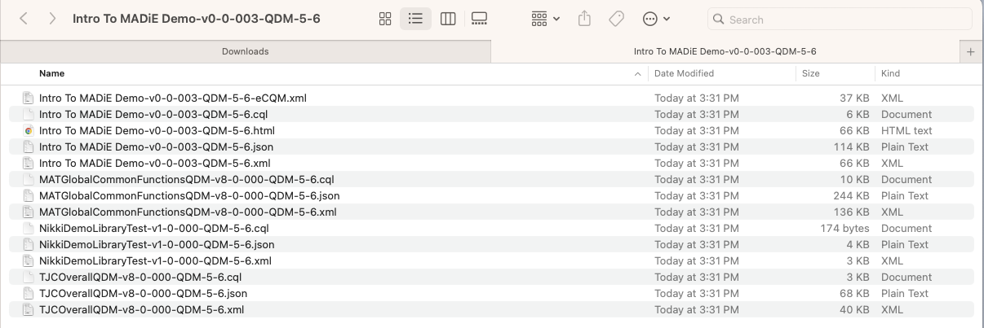
QDM Export File Structure From MAT

Slide 2
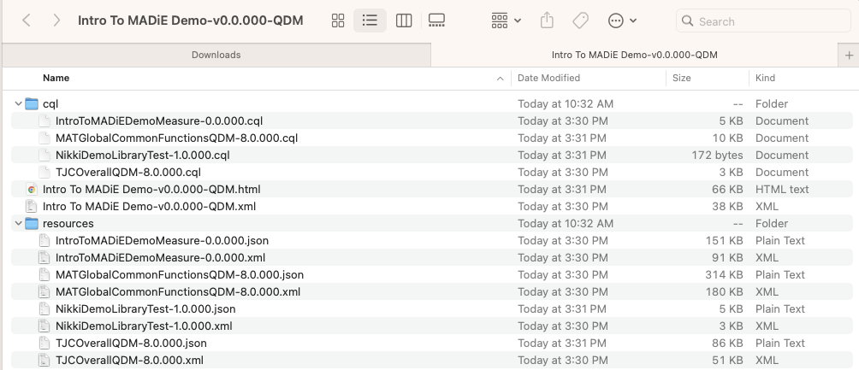
QDM Export File Structure From MADiE

Slide 3
Differences?
MAT
All Files in the base folder
MADiE – Now in alignment with QI-Core Export Format
Measure html and xml in base folder
Cql sub folder
Measure CQL
Included Library CQL
Resources sub folder
Measure JSON and XML
Included library JSON and XML

